Slide 1
Deconstructing the Modern CAD Library
Roger Chin
Application Engineer

Slide 2
Why So Much Focus On Libraries?
They are the building blocks of EVERY design
When built and managed well…
They provide tremendous reuse if constructed well
Huge time-saver and resource for engineers
Allows for pro-active supply chain readiness and resiliency analysis
When not …
They are often causes of late stage design changes due to incorrect parts or supply chain issues
Hard to find what is needed or select the right device
Lead to inefficiency, redundancy, and frustration
Lego takes great pains to ensure each brick is correct and can be used exactly as intended. Your library should be the same.

Slide 3
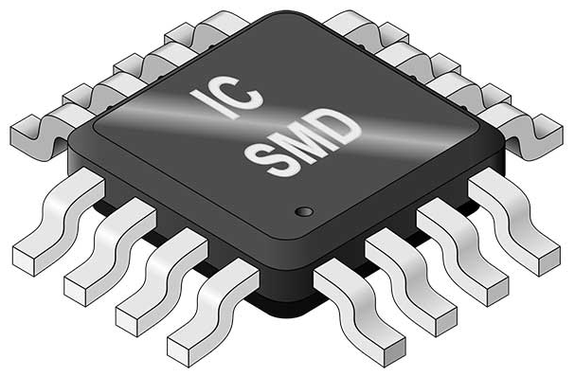
What Does a CAD Library Item Consist Of?
CAD
Models
Supply
Chain
Device Parametrics
Internal Data & Usage

Slide 4
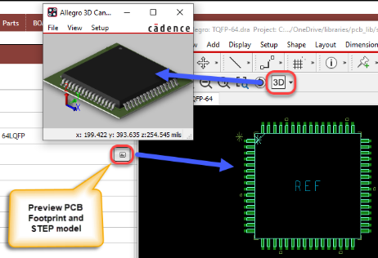
What makes up a modern library?
CAD Models | Searchable Parametric Data | Organizing Components | Approved Part Numbers | Identifying Obsolete or Unavailable Parts
Schematic symbols Layout Footprints Padstacks Mapped 3D models Simulation Models Datasheets | Electrical Parameters Value, Tolerance, Temperature Coefficients, etc. Descriptions Approval Fields Package Dimensions (height, size, weight) | Creating tables and sub tables speed up part searches A customizable database allows for new tables and new fields Ways to make changes and bring in new parts in bulk | Internal company part numbers Managing approved alternates Tracking newly created parts as “Temp” parts Inventory stock Costs PLM fields Where Used | Estimated years to end of life Flagging parts that are not available for purchase Researching good alternate manufacture part numbers

Slide 5
CAD MODELS
PARAMETRICS
SUPPLY CHAIN
INTERNAL DATA
Function
Function
Function
Function
Physical & Logical Geometries for use in CAD tools
Electrical & Functional Parameters of the Device
Pricing, Compliance, and Availability of the Device
Internal Data Labels & Internal Device Usage Data
Consists Of
Consists Of
Consists Of
Consists Of
Value
Dimensions
Lifecycle
Availability
Where Used
AVL
Symbol
Footprint
Tolerance
Coeffcient
Compliance
Risk
Internal PN
Versions
3D Model
Sim Models
Temp
Datasheet
Etc
Pricing
Alternates
PLM/ERP Fields
Data Source
Data Source
Data Source
Data Source
Datasheet & Online CAD Libraries
Datasheet / IC or Distributor Website
Distributor, CM, SC Service
Internal Systems
Data Type
Data Type
Data Type
Data Type
STATIC
STATIC
DYNAMIC
STATIC & DYNAMIC

Slide 6
Distributor PN X
V1
Distributor PN 1
Footprint
Symbol
Value
Temp
V2
3D Model
Sim Models
Dimensions
Datasheet
VX
Manufacturer PN
CAD Models
Tolerance
Etc
Internal PN
Coeffcient
Description
Parametrics
AVL
Associates BOMS
Mapping Out The Data Relationships
(Ideal Case)
Where Used
PLM/ERP Fields
Lifecycle
Availability
History
Alternates
Compliance
Risk
Categories / Taxonomy
Pricing
Alternates
Workflow & Processes
Supply Chain
Internal Data

Slide 7
Distributor PN X
V1
Distributor PN 1
X
Footprint
Symbol
Value
Temp
V2
3D Model
Sim Models
X
Dimensions
Datasheet
VX
Manufacturer PN
CAD Models
i
Manual
Tolerance
Etc
Internal PN
Coeffcient
Description
i
Manual
Parametrics
X
AVL
Associates BOMS
X
Mapping Out The Data Relationships
(Typical)
X
Where Used
PLM/ERP Fields
Lifecycle
Availability
History
Alternates
X
Compliance
Risk
Categories / Taxonomy
Pricing
Alternates
X
Workflow & Processes
Supply Chain
Internal Data

Slide 8
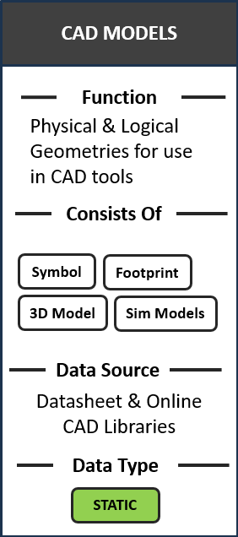
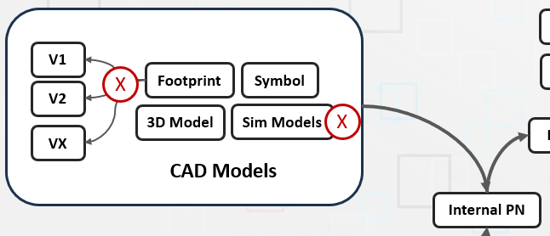
Common Challenges for CAD Models
Sharing libraries between designers and EEs
Tracking and controlling changes to symbols
Building and verifying models
Making sure designs are using latest models
Creating many copies of symbols for discretes
Managing large number/types of files
Figuring out what designs are using what models

Slide 9
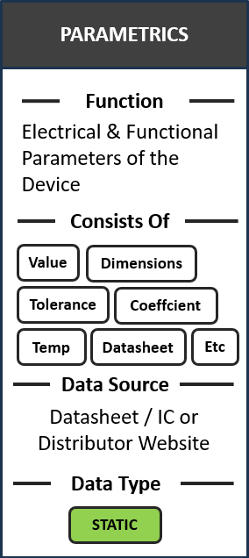
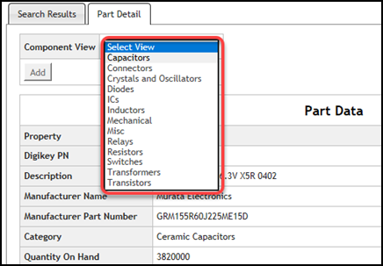
Common Challenges for Parametric Data
Centralizing your parts into tables with different fields
Bringing in your existing libraries into a database of tables
Time and accuracy in pulling data out of datasheets
Standardizing descriptions and field names
Different types of components have different properties
Managing properties symbol by symbol
Researching and finding parts by field data
Collaborating and approving parts

Slide 10
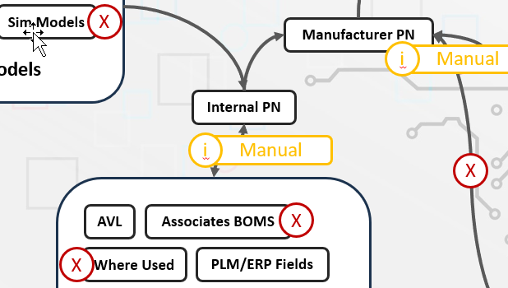
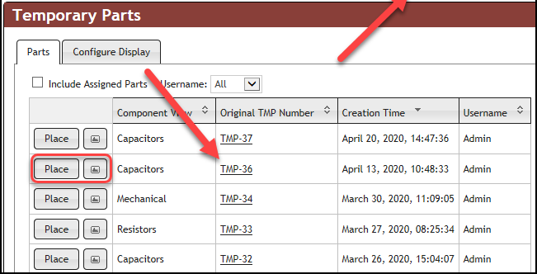
Common Challenges for Internal Part Numbering
Building a part number system and mapping to relational tables
Preventing duplicate internal part numbers
Associating and ordering manufacturer part alternates
Datasheets for each alternate
Managing temporary parts

Slide 11
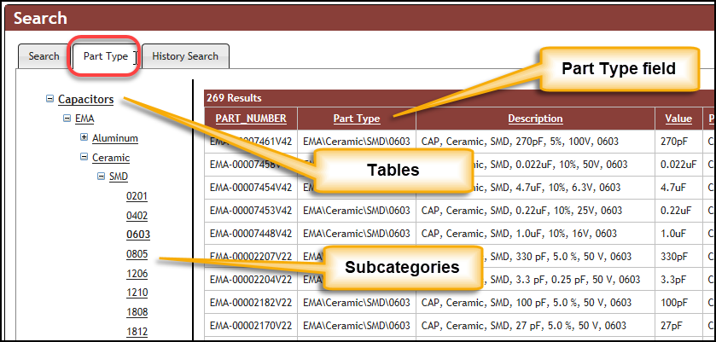
Common Challenges for Database Organization
Building a good foundation to centralize your part database
Importing in your parts into the right tables
Setting up fields for each table
Managing subcategories

Slide 12
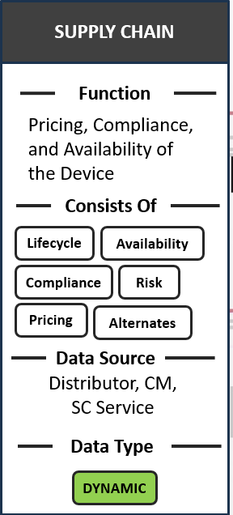
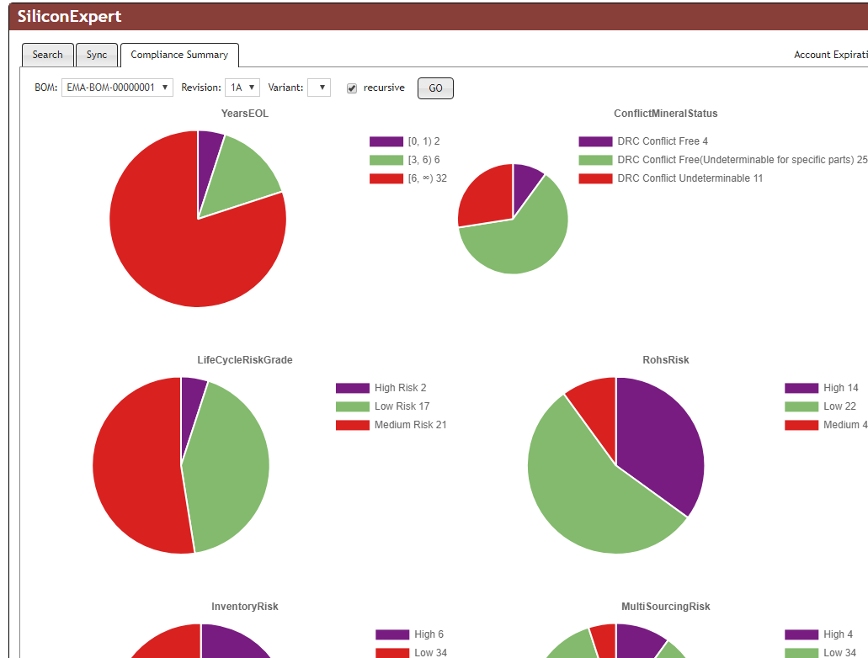
Common Challenges for Part Health & Supply Chain
Keeping track of which parts are going obsolete and when
Automating this to run on a regular basis
Flagging which BOMs are using obsolete or parts that cannot be purchased
Getting documentation for RoHS, Reach, and other compliance
Letting your designers know they are using high-risk parts

Slide 13
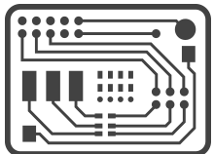
Integrated ECAD Environment
WORK IN PROCESS
RELEASE TO MANUFACTURING
CONTENT SOURCES
Ultra Librarian for OrCAD
20M+ Parts Library
OrCAD CIP
Component Distributors
OrCAD CIP
Compliance Module*
Powered By
Part Request Methodology
CIP – Component Information Portal
OLB
OLB – OrCAD Library Builder
Company part number
Description
Mfr name, mpn
Status etc…
Enterprise Link
Centralized Local Library
CIS – Component Information System
PCB Editor
Reference
Designs
PSpice
OrCAD Users
OrCAD EDM
PLM Ready Package
Work-in-process
Design Data Mgmt.
EDM – Engineering Data Management
Schematic, Board, Manufacturing Files…

Slide 14
Reach out for questions or a live Demo!

